Slide 1
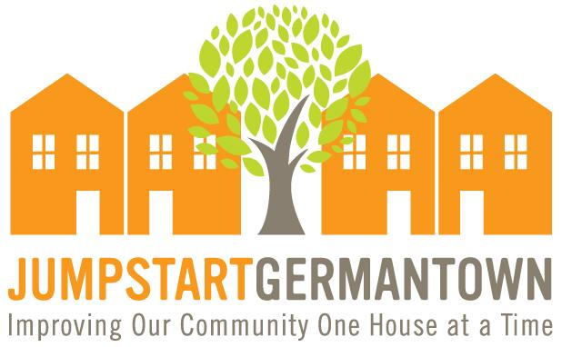
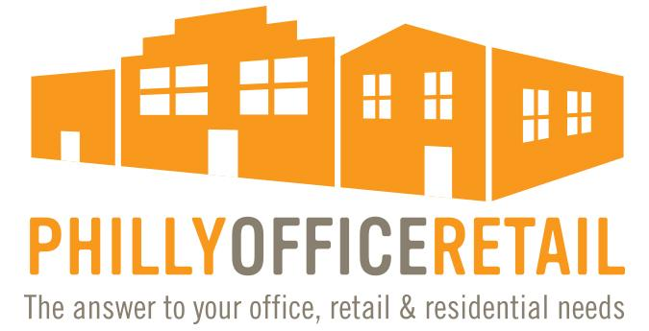
Ken Weinstein
DAG – Design Advocacy Group
February 6, 2020
Notes:
KW intro
Congrats to Brandi Levine and thanks to Sue Patterson
2019 - Year of Change:
for me: closed 2 restaurants (refocus)
co-led campaign to close down GSSD (opportunity to do better)
moved POR offices (increased capacity)
made more progress with Jumpstart Germantown and Jumpstart Philly (new frontier)
started transformation of WJ (Phase I, II and III), etc.
for PKNA: stopped Boys & Girls Club plans to tear down historic building and build ice rink
supported GSSD closure and got Rebecca Rynhart to audit GSSD
PKNA and KW perfect together - activist neighborhood group and activist RE developer - better way to be
2020 - Year of Progress:
Looking forward - what I want to cover today
Cleaning, Greening and Safety in our Commercial Corridor
Adaptive Reuse of area Buildings
Wayne Junction Revitalization, moving into Phase II and III

Slide 2
Philly Office Retail Wayne Junction Revitalization
Notes:
Passion - blight removal and adaptive reuse
describe background
Let me run through a few of our Germantown projects
WJ Phase I - done or under construction
WJ community projects:
Mural Arts - $151,000
Pocket Park - $225,000
pedestrian crossings and traffic calming
street trees
trash cans
new lighting

Slide 3
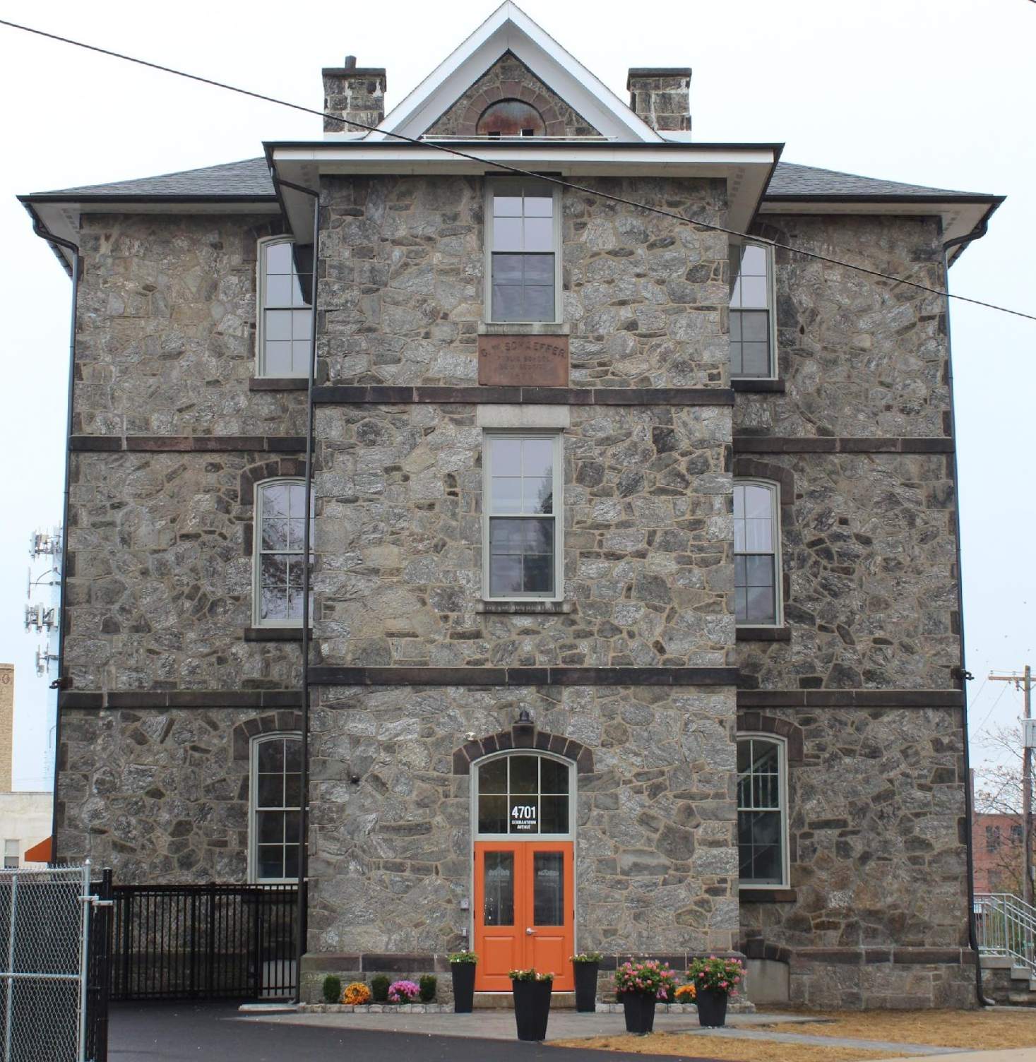
Wayne
Junction
Phase I
4701 Germantown
Avenue
Notes:
Schaeffer School - 1876
POR stabilized when purchased in 2011 for $150k (roof, carpentry, structural)
Leasing - no interest
needed to create our own use
Now: POR offices, Jumpstart Germantown Co-working community
Zoning – RSA-3
Federal and State Historic Tax Credits
Construction
$2.1M
historic increased costs (windows/doors, etc.)

Slide 4
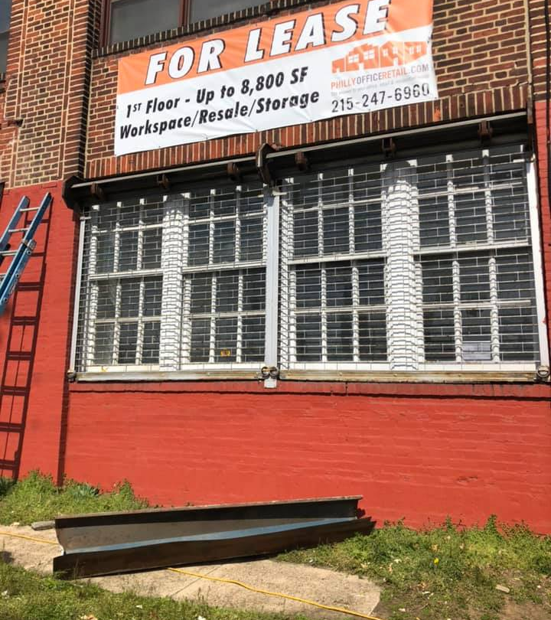
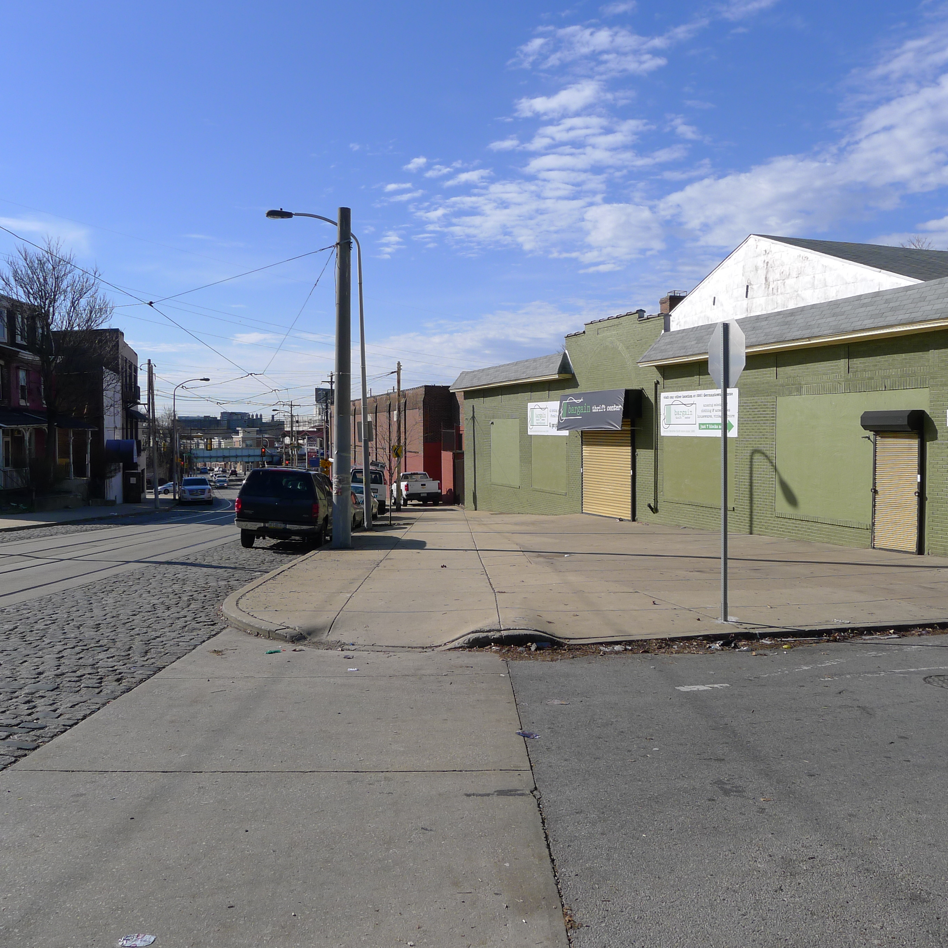
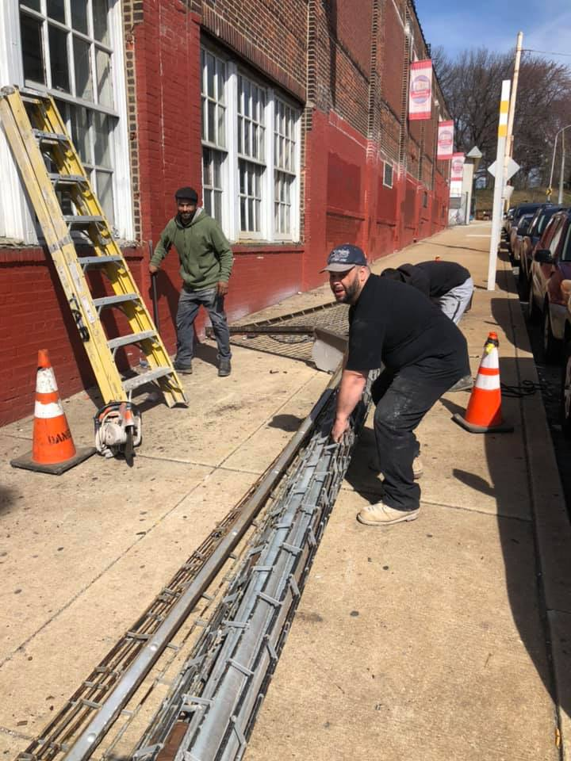
Wayne
Junction
Phase I
4530 Germantown
Avenue
Notes:
Oil Burners
Over 30,000 sf
POR purchased in 2016 for $545k
Due Diligence - environmental issues
lease back 12k sf to seller’s daughter
Bargain Thrift - consolidated space
Philadelphia Woodworking - relocated from Kensington
Philly Bread – moved from Olney – retail coming soon
Recently removed grates from windows!
I-2 zoning - by right
lighting and Philly Bread painted signage on Germantown Avenue side

Slide 5
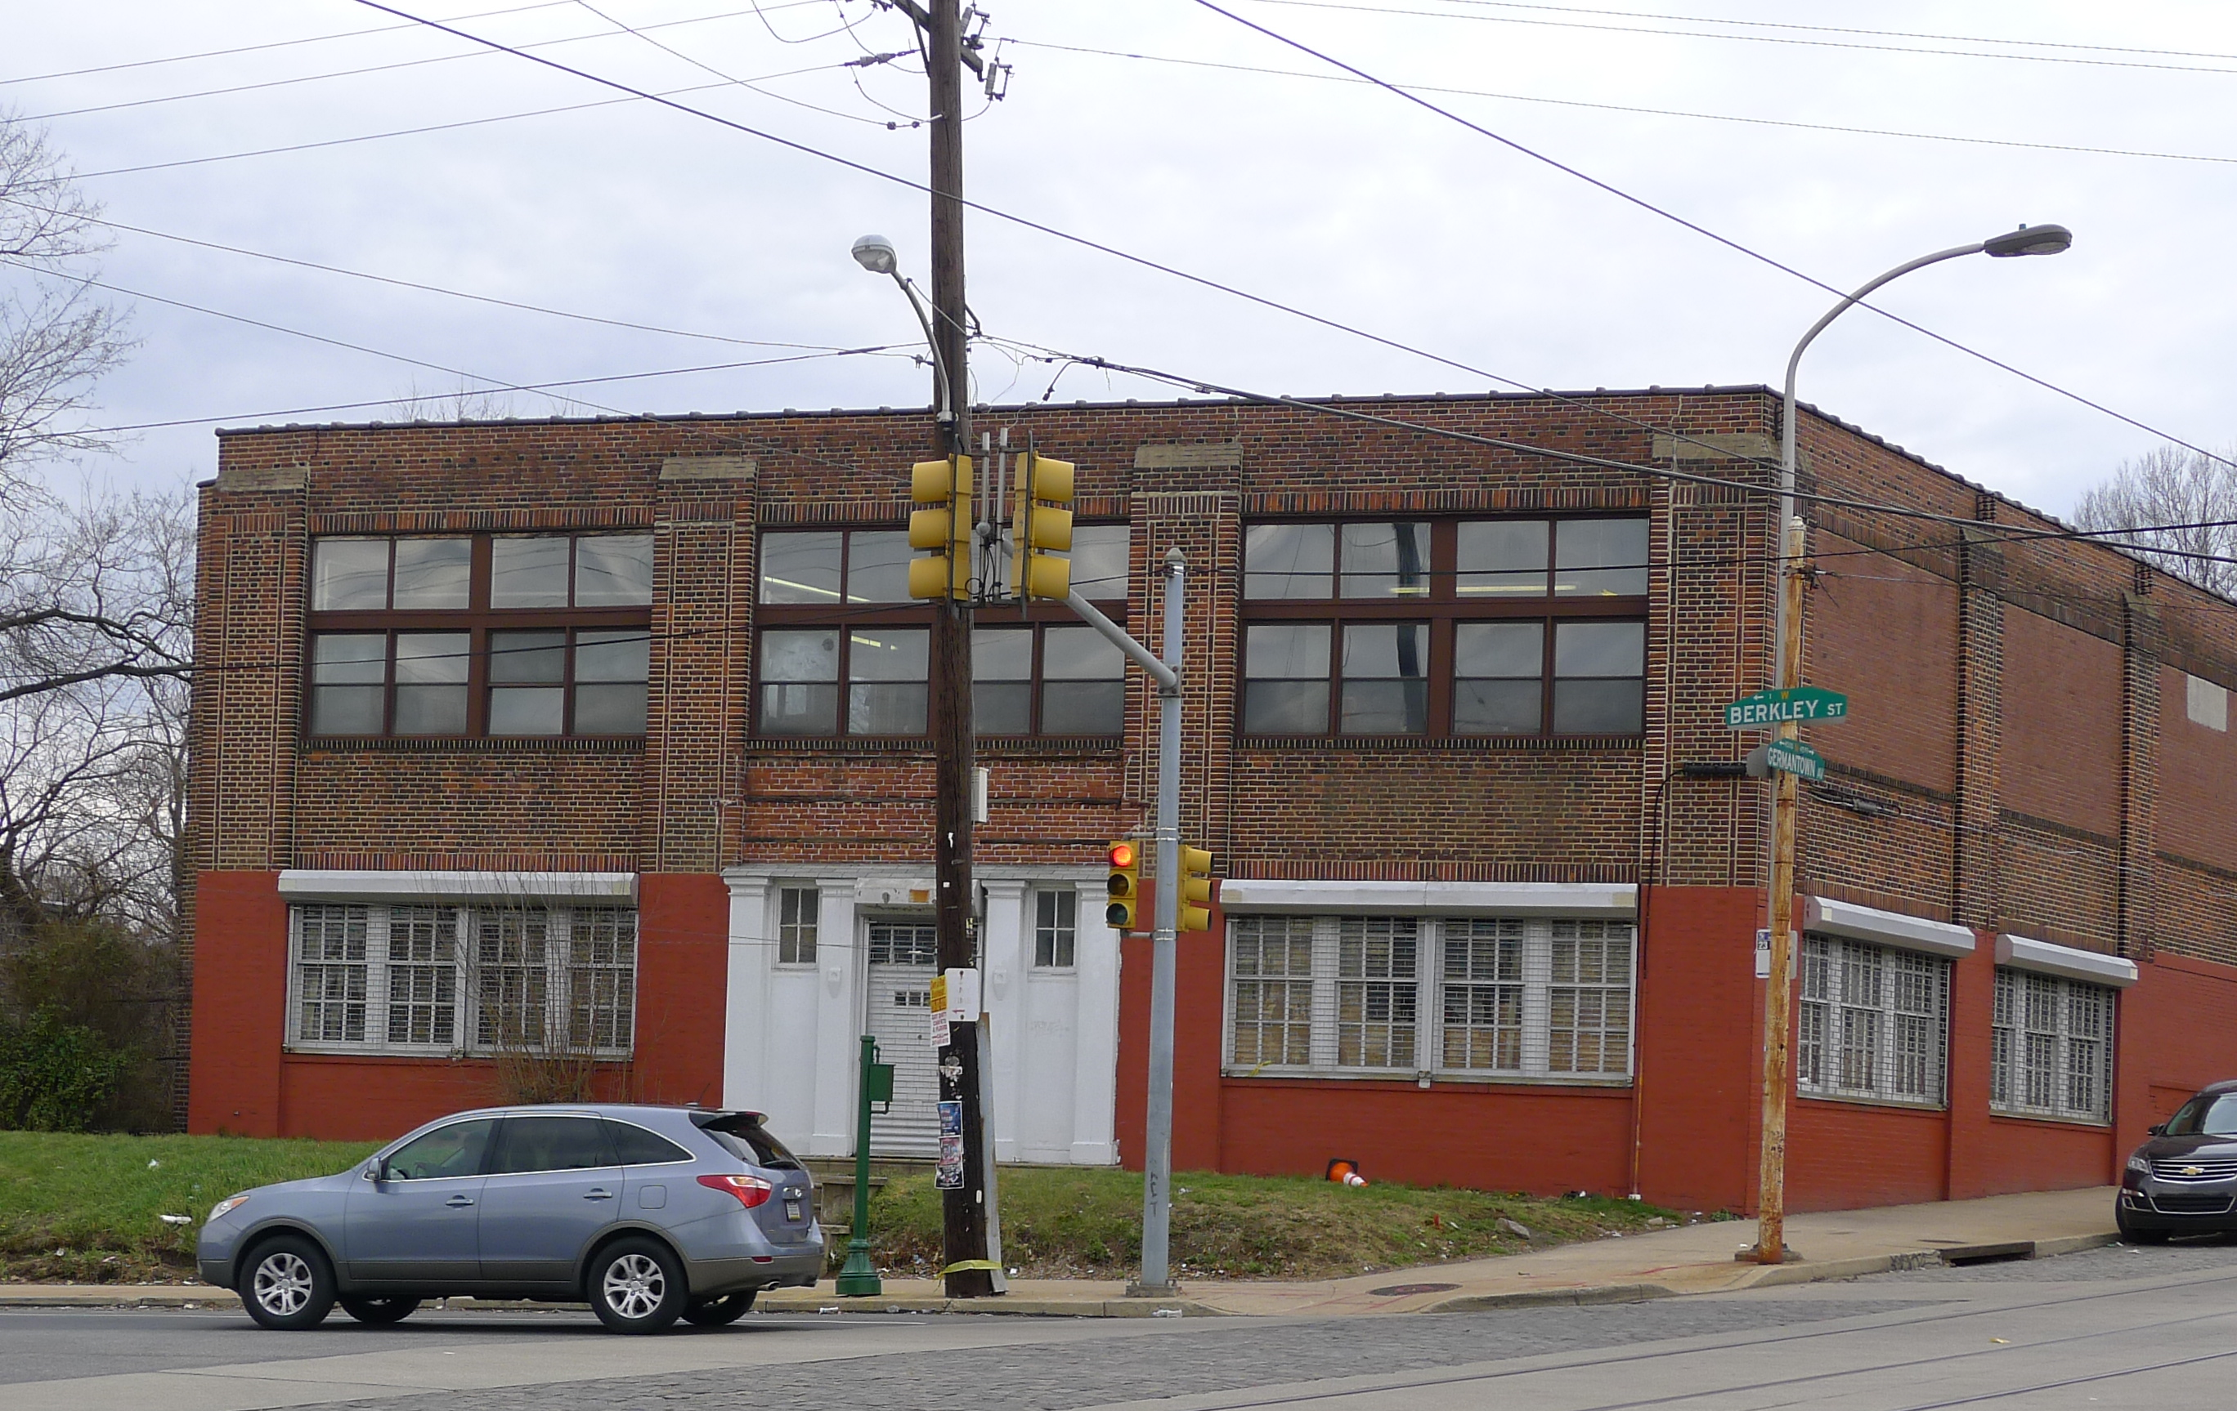
Notes:
Oil Burners
Over 30,000 sf
POR purchased in 2016 for $545k
Due Diligence - environmental issues
lease back 12k sf to seller’s daughter
Bargain Thrift - consolidated space
Philadelphia Woodworking - relocated from Kensington
Philly Bread – moved from Olney – retail coming soon
Recently removed grates from windows!
I-2 zoning - by right
lighting and Philly Bread painted signage on Germantown Avenue side

Slide 6
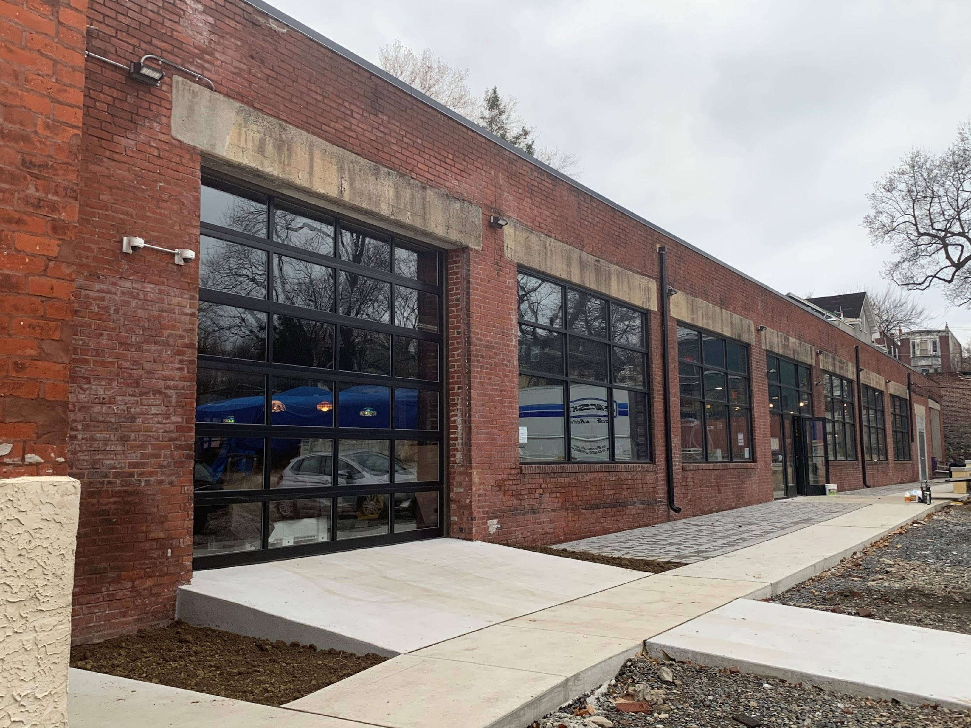
Wayne
Junction
Phase I
137-45
Berkley Street
Notes:
Bladsell Pencil Factory
POR purchased in 2016 for $225k
6,000 sf and 10,400 sf
Historic rehab - PHC - full size windows
Current tenants: Fourfront - SEO Optimization and Attic Brewing - Hazy IPA
Coming soon – Deke’s BBQ
Wayne Junction Historic District established in 2018 - strongly supported

Slide 7
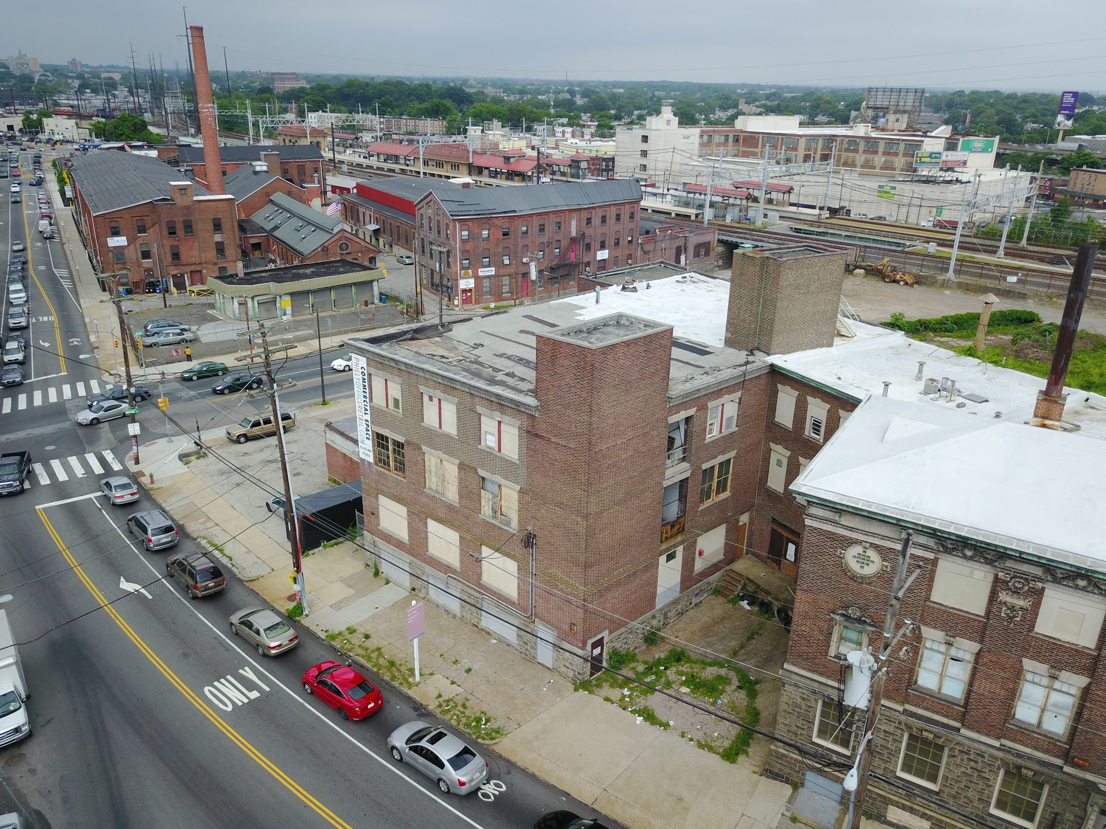
Wayne Junction Phase 2
212 Roberts Avenue
Notes:
Max Levy Building - 1902
26,665 sf building
POR purchased in 2012 for $150k
Plans - 32 apartments
shovel ready
waiting on financing from Penn Community Bank - approval tomorrow
State and Federal Historic Tax Credits - Full restoration including full size windows
Zoning – I-2 industrial - variance needed

Slide 8
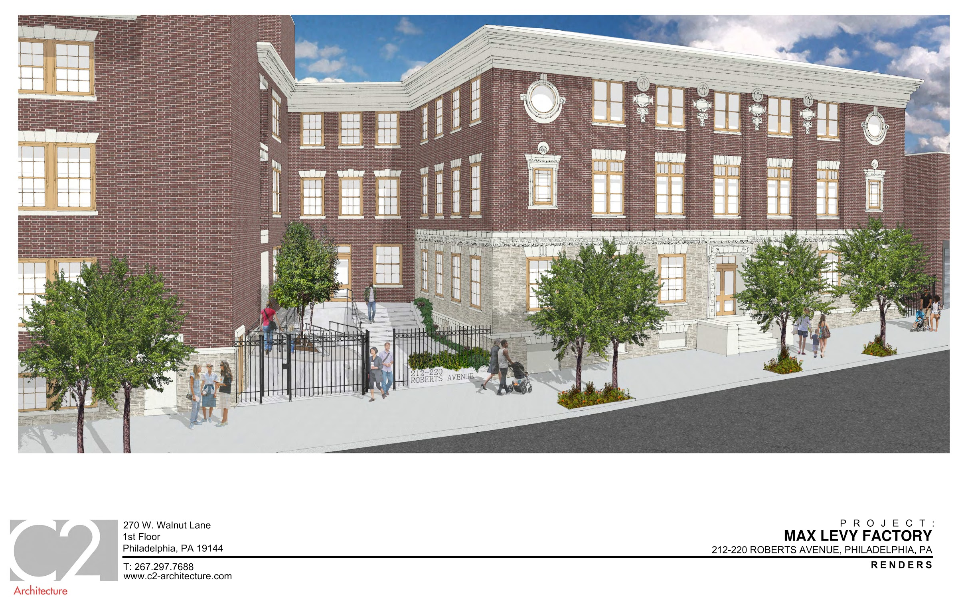
Notes:
Schematic of what it will look like when completed

Slide 9
Wayne Junction Phase 2
113 Berkley Street
Notes:
Moore Push Pin Factory - first manufacturer of X-Rays in US
POR Purchased in Oct 2018 for $375k
14,800 sf building
Plans for office/retail space - waiting for leases - non profit, barista school, contractor training school
structurally unsound rear - will start demo of add on buildings soon

Slide 10
Wayne Junction Phase 3
133 Berkley Street
Notes:
POR purchased the lot from Wayne Mills 2017 for $125k (they had used it as temporary parking)
Summer of 2018 moved 1950 Mountain View Diner from Willimantic, CT to the lot. Wayne Junction Diner
2019 - determined that this site would not work for WJ Diner because City collapsed old factory building into the site - would have to dig out 8 feet of debris and replace soil - financially infeasible
short term - parking for 137 and 113
long term - new construction building by right

Slide 11
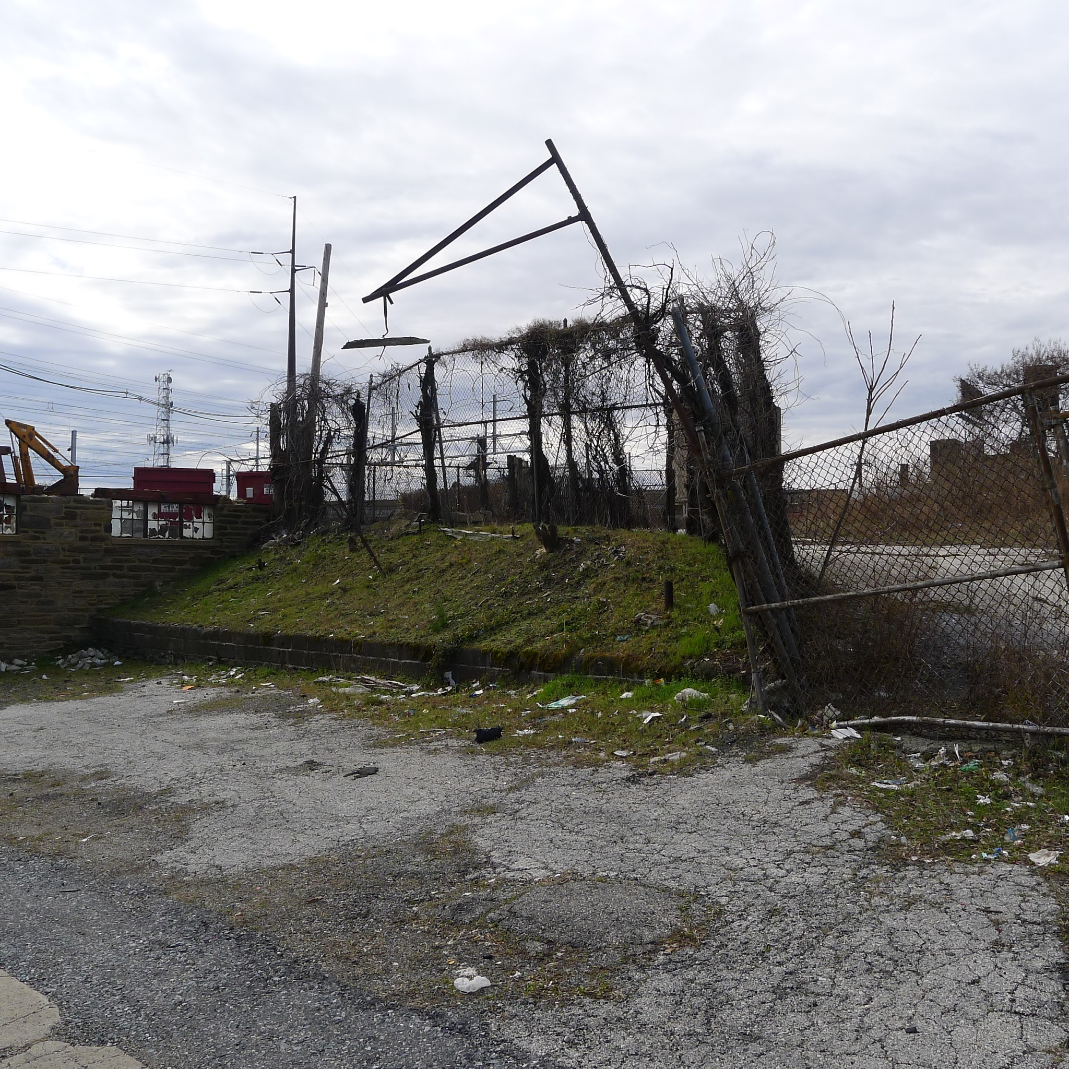
Wayne Junction Phase 3
4518 Wayne Avenue
Notes:
Across from Train Station, 45,500sf - 1 acre
POR purchased in July 2018 for $350k
Will cost about $300k for environmental remediation - another factory demolition
long term - new construction
talking to design, architecture, fabrication company looking to occupy 75,000 sf

Slide 12
Notes:
better view of site

Slide 13
Policy Changes Impacting Redevelopment
Notes:
1. Private Developers
Do-ers
Push/Maneuver system
Legal vs Illegal (i.e. permits)
Not all good, not all bad
Roles they play
Site planner
Marketing/Place-making
Liaison w/ neighborhood
Lobbyist w/ City
How developers navigate city
City’s regulations in place to protect from bad development - sometimes inhibits good development

Slide 14
Changes to the 10 Year Tax Abatement
- affects new residential construction
- no change for rehab projects or commercial
- begins Dec. 31, 2020
New Incentives for Historically Designated Properties
- reduce parking requirements
- allow accessory dwelling units (ADUs)
- more allowable uses in “special purpose” historic buildings
Notes:
Changes to 10 year Tax Abatement
Starting in 2021, anyone who buys new residential construction will see the tax abatement go down by 10 percentage points each year during the decade it is in effect roughly halving the savings to the homeowner.
The tax break will not change for rehabilitation projects or commercial construction, which will receive a 100% tax break on their added value for a full decade.
The changes will not affect projects for which abatement applications are submitted before Dec. 31 of next year.
Historic
change requirements for locally certified properties by reducing parking requirements, allowing accessory dwelling units, and allowing more uses in “special
purpose” historic buildings.

Slide 15
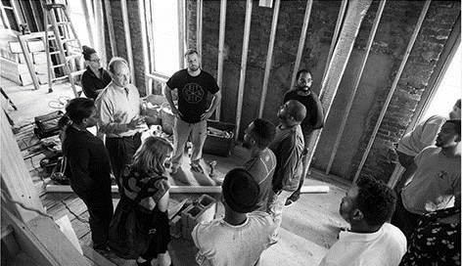
The Jumpstart Model
Notes:
Intro –
POR - mission, 800Ksf, 30 years, staff of 20+
VGB - Univest
PHDC – BSRP, Adaptive Modification, Weatherization
COS city council
MA BID
Financial/Social Mission (50/50) – Do Well by Doing Good
Focus on urban neighborhoods/blight removal
Community developer – triple bottom line – people, profit, planet, take larger view

Slide 16
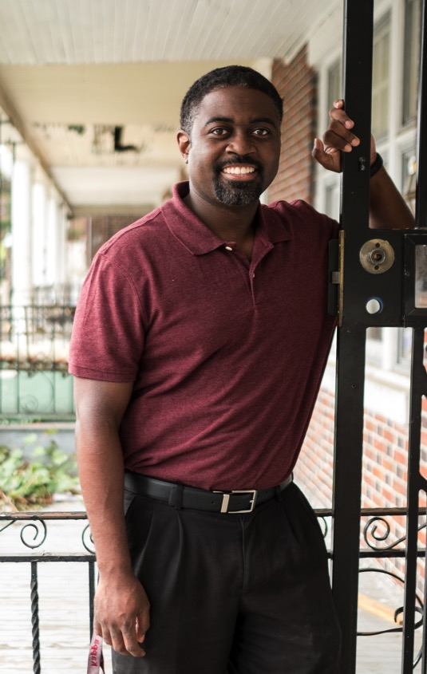
Jumpstart Philosophy
Doing well by doing good
A. Reducing blight
B. Improving your community with less gentrification
C. “Growing the Pie”: Sharing resources
D. Gaining community support, and a marketing advantage, by being a good neighbor
E. Reckoning with risk
F. Investing in your future: Creating a nest egg
G. Changing the face of development: Diversity
Notes:
Started 4 years ago
Why Jumpstart?
Improve neighborhoods while keeping gentrification at bay
Remove blight
Create opportunities for local entrepreneurs
Diversity – changing the face of RE Development
Build wealth locally – create nest eggs
Scattered site rehab – not urban renewal
Health mix of affordable and market rate housing
Slow, steady growth vs. explosive growth
Keep people in their homes – PHDC BSRP, new Loan Fund for middle income
Better than rehabbing vacant properties
A. Reducing Blight
Renovating dilapidated properties
Improve neighborhood safety
Increase property values and owners’ equity in their homes
B. Improving your community with less gentrification
target scattered sites, not “urban renewal”
create a healthy mix of affordable housing and market-rate housing
avoid gentrification through slow, steady growth and growing wealth locally
C. “Growing the Pie”
The Jumpstart approach is more collaborative than competitive. By sharing resources and information, Jumpstart participants can do more together than they can do alone.
Instead of fighting over a piece of the pie, focus on growing the pie!
Form networks and partnerships with other realtors, developers, and owners, and share information instead of hoarding resources.
According to the “80/20 rule.” Only 20 percent of people in real estate openly share information and resources. Be a part of the 20 percent.
Use the Developers’ Network Facebook page on a regular basis
D. Gaining community support, and a marketing advantage, by being a good neighbor
Take the time to connect with neighbors near your development project, and build their trust.
Knock on doors and introduce yourself.
Leave a note, with contact information, if nobody is home.
Use neighbors as a marketing tool and as eyes and ears on your project.
Be a neighborhood partner, not an adversary.
Explain how your development project benefits the community.
Don’t minimize, ignore, or belittle neighborhood concerns or suggestions.
Attend neighborhood meetings and get to know the larger community.
E. Reckoning with risk
Make no mistake: Real estate development is risky, and it’s not for everyone.
Lack of experience and lack of capital are the two most common reasons why people don’t pursue real estate development as a career. Jumpstart is designed to remove these roadblocks so almost anyone—who’s willing to take the risk—can become a developer.
F. Investing in your future: Create a nest egg
Create a financial nest egg, so you and your family can live more comfortably, by investing in your neighborhood. By establishing a financial base through real estate, you can smooth unanticipated bumps and turns in the road.
G. Changing the face of development: Diversity
One of the goals of Jumpstart is to support women and minorities in entering the field of real estate development. By diversifying the development field, more people, of different backgrounds, can benefit. More than 80% of our graduates, so far, are women or people of color which is very different than the industry which is very white male.

Slide 17
Jumpstart Germantown Initiatives
1. Training Program
2. Developers’ Network
3. Loan Program
Notes:
How do we do it?

Slide 18
Jumpstart Germantown
Training Program
85%+ Women and/or People of Color
750 Graduates to date
12 Hours Instruction
Access to a Mentor
Notes:
20th training program starts tomorrow!
Received more than 1400 applications to date
685 Graduates – 85%+ people of color and/or women
12 hours plus mentor
3-4 Sessions per year; 65 Developers per session

Slide 19
Jumpstart Germantown
Loan Program
$15.9M
150
Committed since
May 2015
Number of Loans Closed
$110k
59% For Sale
41% For Rent
174 Total Units
Renovated
Average Loan
Amount
Notes:
150 loans
$15.9 M committed
Avg loan size - $110k
Buy & Hold – 41%
Buy & Sell – 59%
Total Housing Units - 174

Slide 20
Beyond Germantown
Six additional Jumpstart programs
Hunting Park
Southwest
West Philly
North Philly West
Kensington
Tioga
Notes:
Hunting Park – Hunting Park NAC – Charles Lanier
Southwest – Southwest CDC – Steve Kuzmecki
West Philly – Enterprise Center & Habitat (Jesse Blitztein & Tya Winn)
North Philly West – Robin Miller
Kensington – Shift Capital & Impact Services (Matthew Grande & Casey O’Donnell)
1st three listed above received seed grant from LISC
Coming Soon:
Wilmington
Norristown
Interested:
Oklahoma City
Milwaukee
Chicago
Detroit

Slide 21
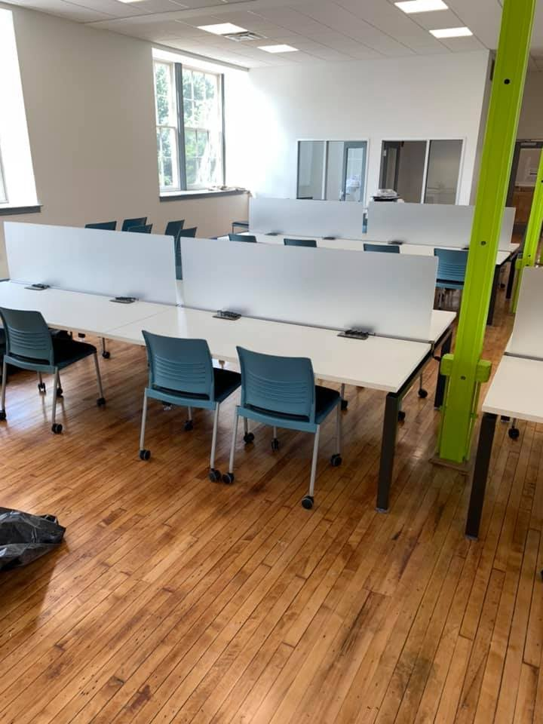
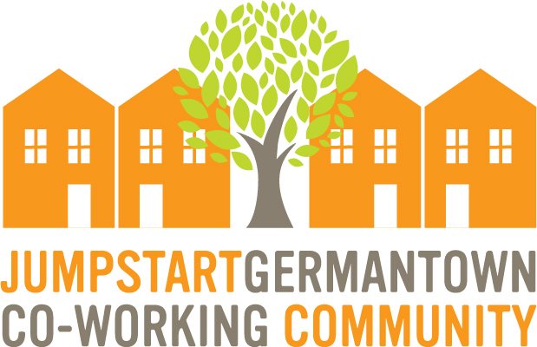
Co-Working Community
MORE THAN A WORKSPACE – A COMMUNITY
Memberships start at $150/month
Opportunity to share ideas/resources
Plenty of amenities
Located below Philly Office Retail
Event Space Available
Notes:
The Jumpstart Germantown Co-working Community
Wayne Junction Train Station is just two blocks away and a 10 minute ride to center city
on and off street parking and plenty of open space for you to set up your laptop and enjoy fast wifi. The Jumpstart Germantown team offers programming, providing workshops and other opportunities for you to learn and meet potential partners or team members.
Community Membership $150 per month
Dedicated Desk $300 per month
Training Room (holds up to 35 guests) $50 per hour
Large Conference Room (holds up to 10 guests) $25 per hour
Main Room (holds up to 200 guests) $100 per hour
AMENTIES INCLUDE:
Mail Room
High Speed Internet
Printer/Scanner
Kitchen
Training & Networking Sessions

Slide 22
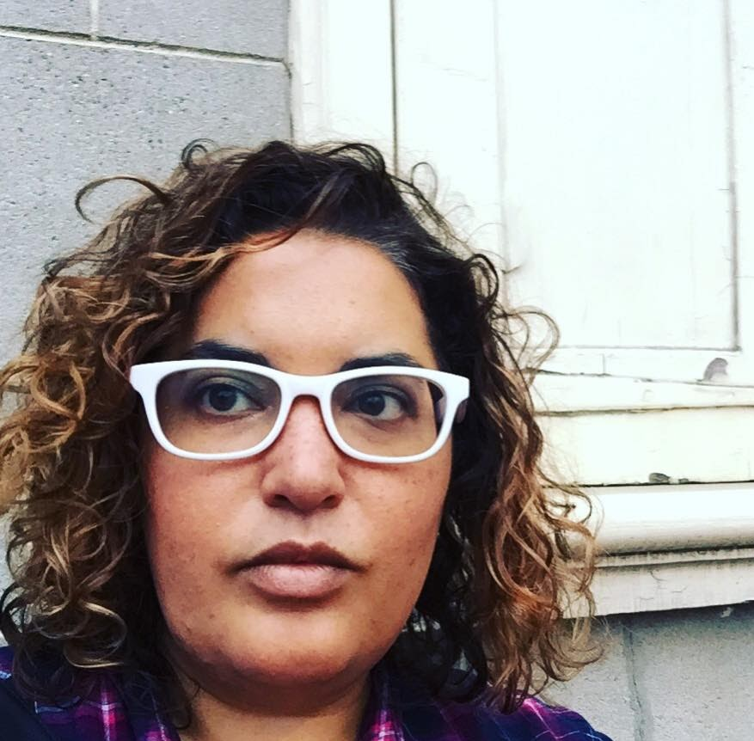
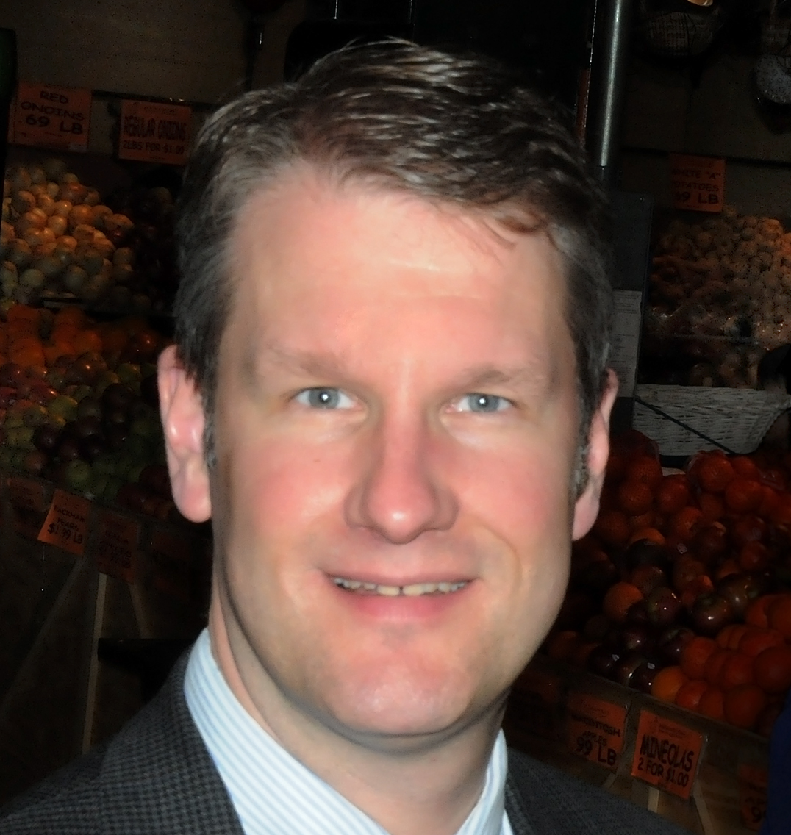
Mini Training Sessions
CONTINUING THE LEARNING PROCESS
Real estate education á la carte
Variety of topics
Monday evenings @ 7pm
Registration Required
Free to Attend
Notes:
Each week we host mini training sessions on topics ranging from Title Insurance to Construction Budgeting, Staging to Permitting
If you have a topic you’d like to present – contact Angie@PhillyOfficeRetail.com
Upcoming sessions:
Jan 27 – Paul Steinke – Historic Preservation: Renovation & Re-Use
Feb 3 - Helenah Warren - WURD – How do you Overcome Stress and get unstuck?
Feb 10 – Kevin Mathisen – The Rehab Timeline – From Demo to Trim
Register online – JumpstartGermantown.com/events

Slide 23
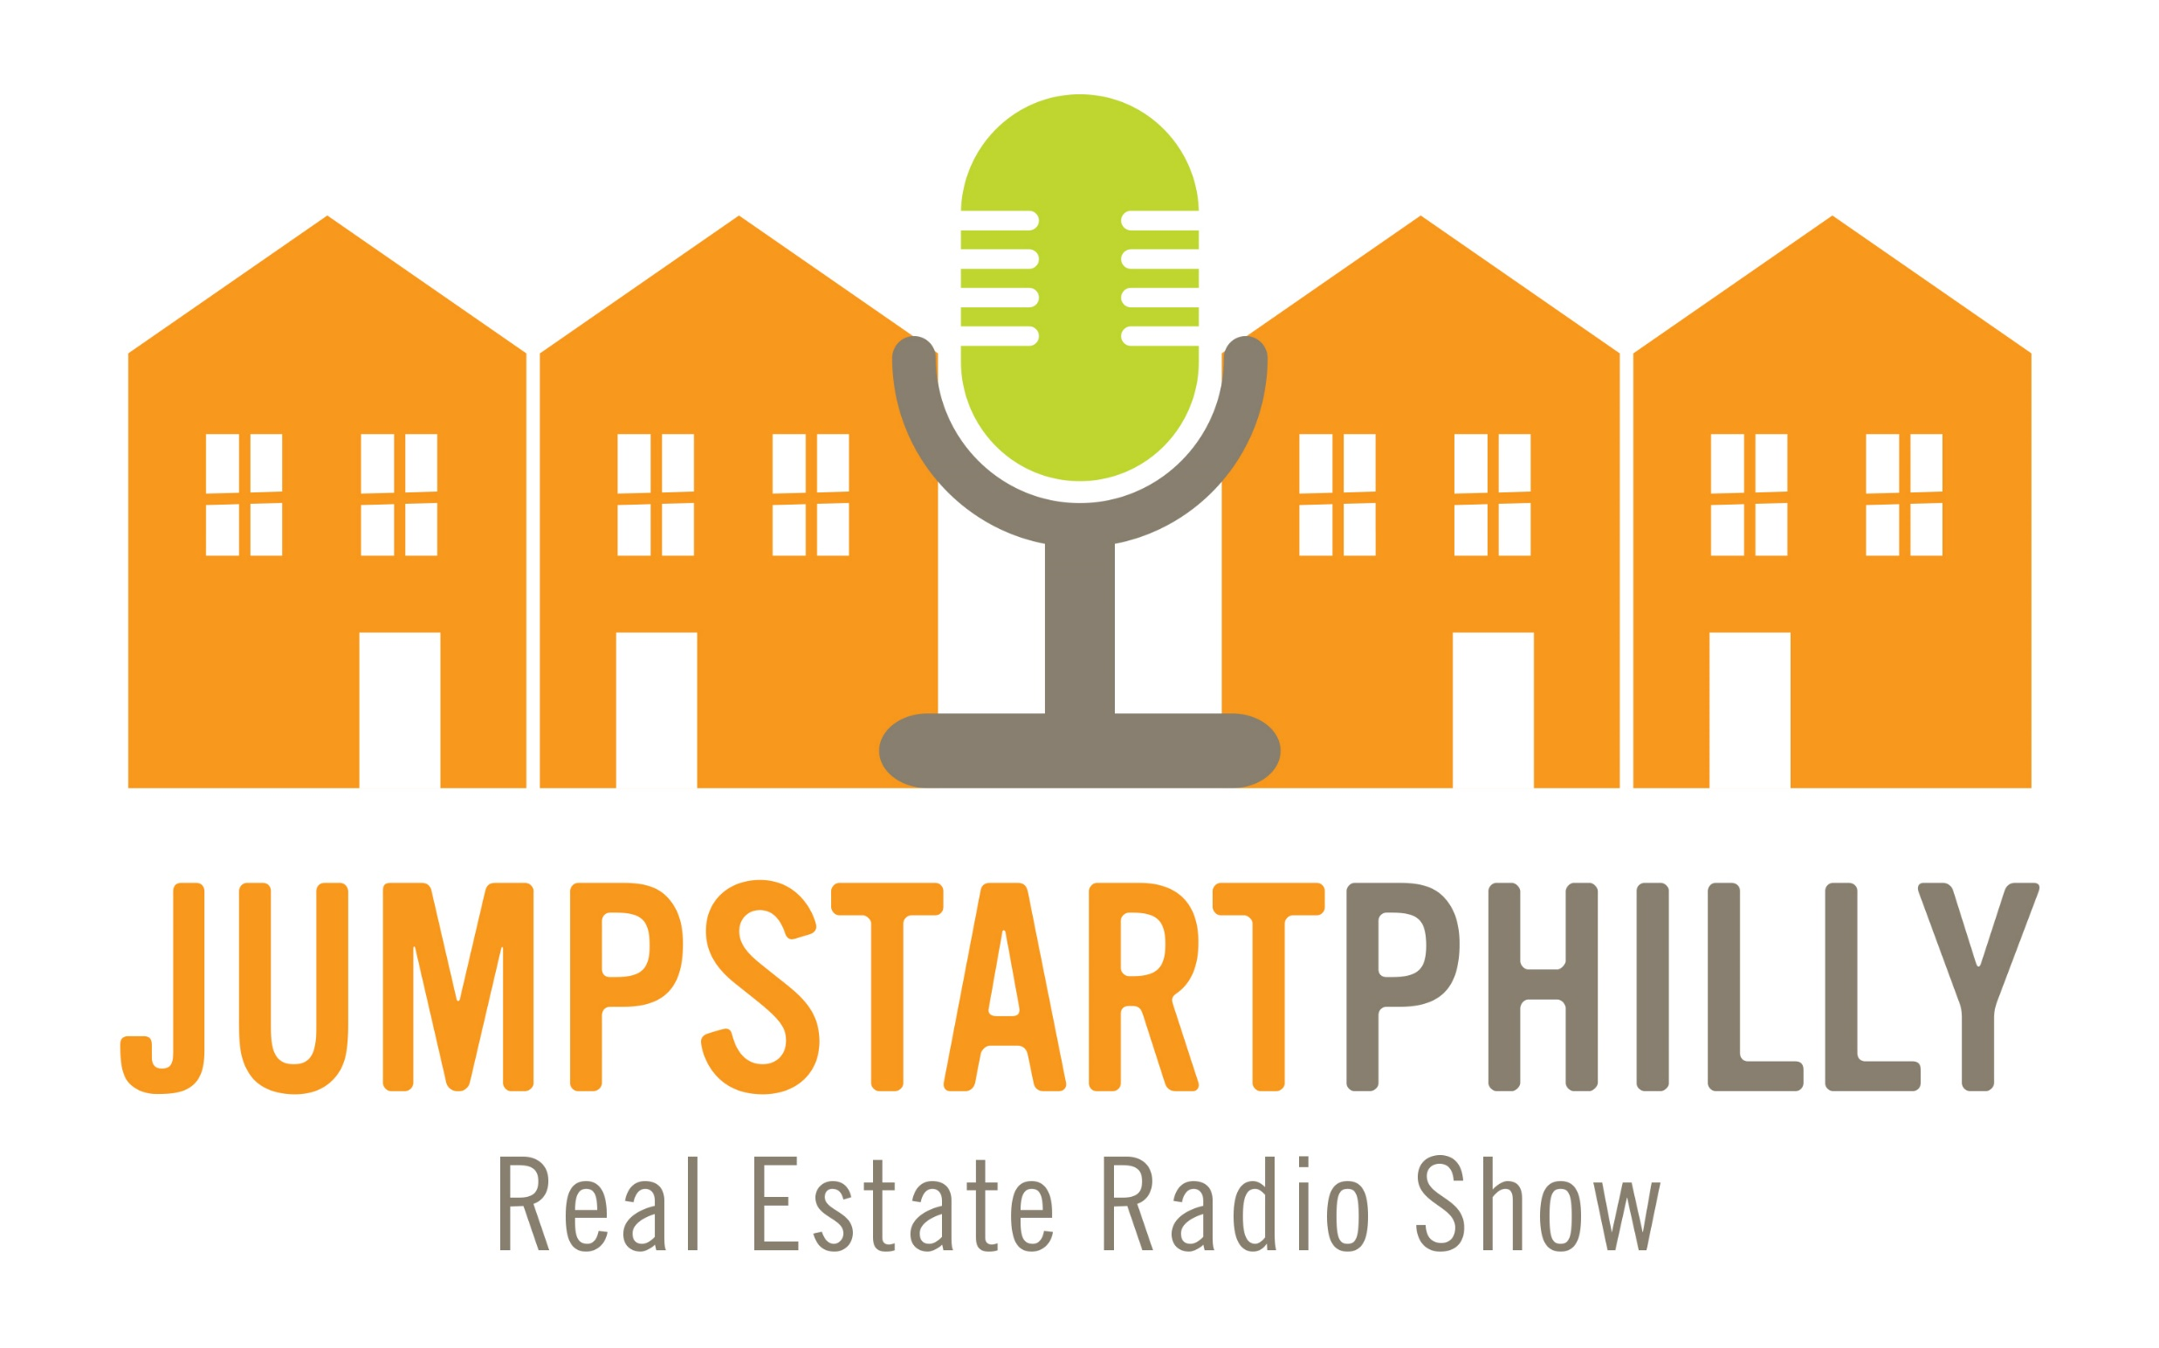
Jumpstart Philly
Real Estate Radio Show
Listen at 92.9FM Fridays @ 10am or listen to podcast at JumpstartGermantown.com
Recorded Live at G’town Radio
More than 20 interviews to date
Highlights positive real estate development and neighborhood revitalization
Notes:
Eleena de Lisser – a former business journalist for the Wall Street Journal and current director of marketing communications at the Wharton School.
Recent guests include:
Ross Hennesy – Rigby Housing
Stan Smith – Smith Houston
Tya Winn – Habitat for Humanity & Jumpstart West Philly
Joseph Console – RE Atty
Matthew Grande & Bryant Riley - Shift Capital/ Jumpstart Kensington
Nicole Purvy – Better Than Success
Jordan Ferrarini – Trades for Difference

Slide 24
Providing Opportunities for Jumpstarters
JUMPSTART PHILLY LOAN PROGRAM
Available in Jumpstart neighborhoods w/out a loan program
Borrower must be a graduate of a Jumpstart Training Program
Details @ JumpstartPhilly.com
Notes:
LENDING BOUNDARIES
Jumpstart Philly provides loans in the following Jumpstart areas:
Hunting Park
North Philly West
Southwest
Tioga
West Philly
Jumpstart Germantown and Jumpstart Kensington operate their own loan programs, and properties within their boundaries are not eligible for Jumpstart Philly financing.
Since September, closed on 7 loans totaling $800k, 3 closing next week (another $300k).
6 in West Philly, 1 in NPW, 1 in Tioga
COST DETAILS
$225 Initial Inspection Fee (non-refundable, due prior to inspection, applied towards the $1500 Loan Commitment Fee if approved)
8.78% Annual Interest (subject to change monthly).
$1,500 Loan Commitment fee (includes up to 4 draw inspections, each additional inspection is $250).
$275 Legal fee (rolled into the loan). Additional fee if more than 2 borrowers/members.
2% Loan fee (rolled into the loan)
Extension fees - 2% for each additional 3 month period (maximum of 2 loan extensions)
All expenses are the responsibility of the borrower (e.g. title, recording, transfer tax)
LOAN DETAILS
Due to state and federal regulations, the property cannot be the borrower’s primary residence.
Lender title insurance policy required.
First Lien placed on property
Interest only monthly loan payments due after construction is completed.
Funding will be advanced as work is completed. No construction funds disbursed at settlement.
No outstanding liens on property at the time of loan closing
Maximum loan per property: $350,000
Maximum loan per borrower: $500,000
Affordability restrictions apply: See chart for rent/sales restrictions.
Rental properties at 70% AMI (Area Median Income)
For-sale properties at 90% AMI (Area Median Income)

Slide 25
Jumpstart 2.0 Commercial Real Estate
Accepting Applications Until Feb. 9
Expected launch date: March 2020
7 Week Training Program
For experienced developers with at least 10 completed projects
Networking sessions and mentoring
jumpstartphilly.com/cre
Notes:
Jumpstartphilly.com/cre
To expand the Jumpstart Germantown Training Program model by providing experienced residential real estate developers a comprehensive introduction to developing commercial real estate in Philadelphia.
The program would consist of the following:
An intensive 7-week instructional training program
Networking sessions
Mentoring upon successful completion of program
Program launch date: March 2020
Program Length: 3-hour classes conducted over seven consecutive weeks (21 hours of instruction)
Class size: 12 to 15 people for the first cohort
Purpose: To remove blight along Philadelphia’s many commercial corridors.
Who should attend:
Experienced single family residence (SFR) landlords, rehabbers, or investors who are looking to expand into CRE
Admission criteria:
At least 10 SFR buy and holds or fix and flips in the last three years
City of Philadelphia residents receive priority

Slide 26
Thank You! Questions
Notes:
Thanks
Q & A

