Slide 1
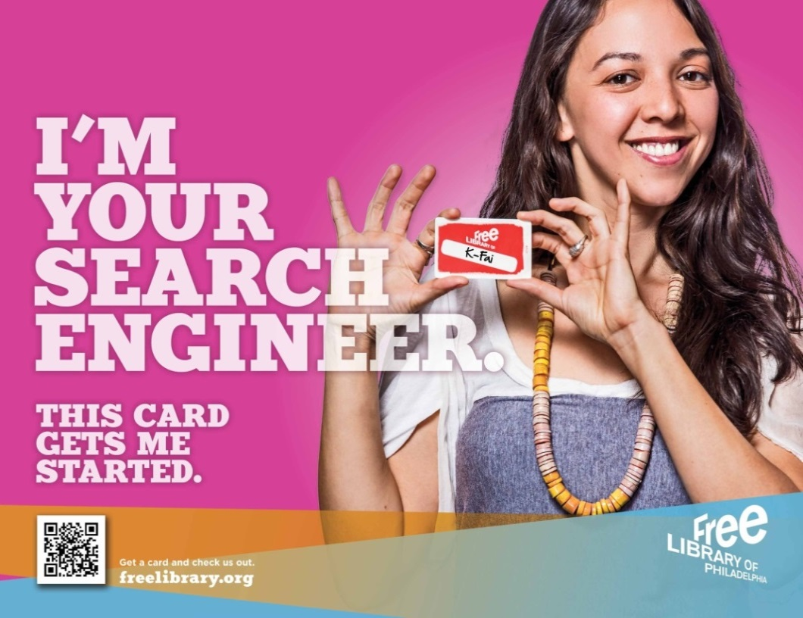
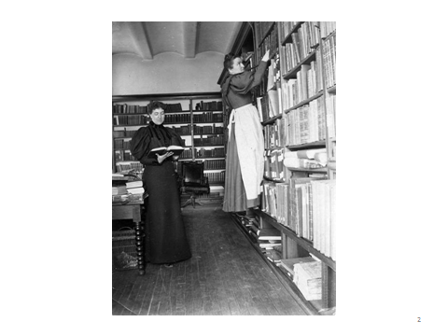
Learning from Undoing
21st Century Designs for 21st Century Library Services
Design Advocacy Group Presentation
December 5, 2019

Slide 2
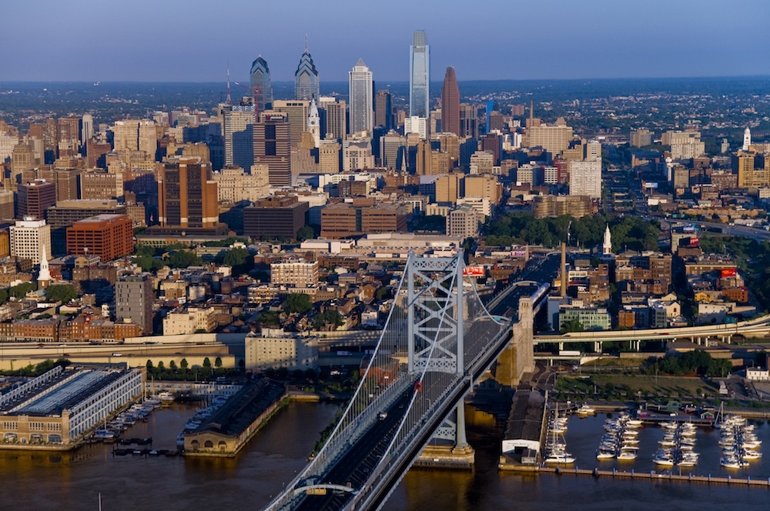
Philadelphia, PA
1.56 million residents
6th largest US city
(by population)
It’s an old city
It’s a politically interesting city
It’s a city of promise
It’s a city of entrepreneurs
It’s a city of many neighborhoods and churches
It’s a civically engaged city
It’s a poor city
25% poverty rate
50% low literate adults

Slide 3
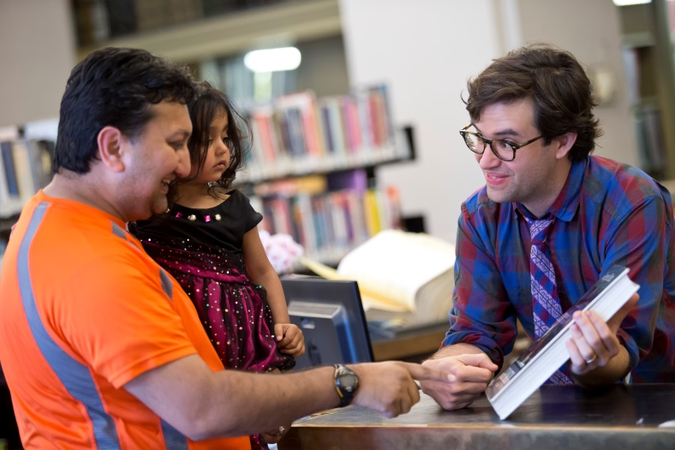
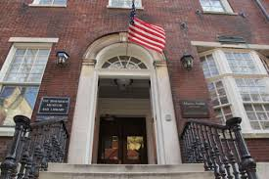
A little bit about the Free Library of Philadelphia
There are 1300+ full-time and part-time employees
There are
54 library facilities
3 Hot Spots
Airport Lounge
We produce over 25,000 programs annually
We have the benefit of a Foundation
We aligned forces with the Rosenbach Museum and Library to create the largest publicly accessible rare book collection in the US.
We are an organization that invites risk and innovation…and at the same time we are afraid of our own success
We have our own beer!!

Slide 4
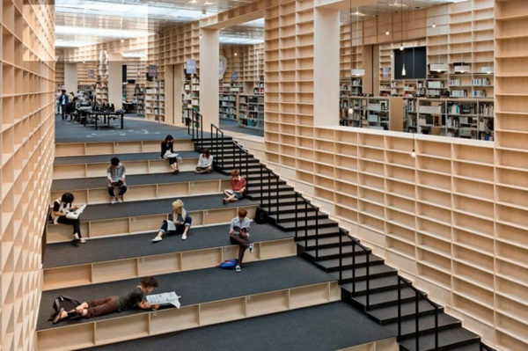
Space makes Place
NYPL 53rd Street Library
Buildings

Slide 5
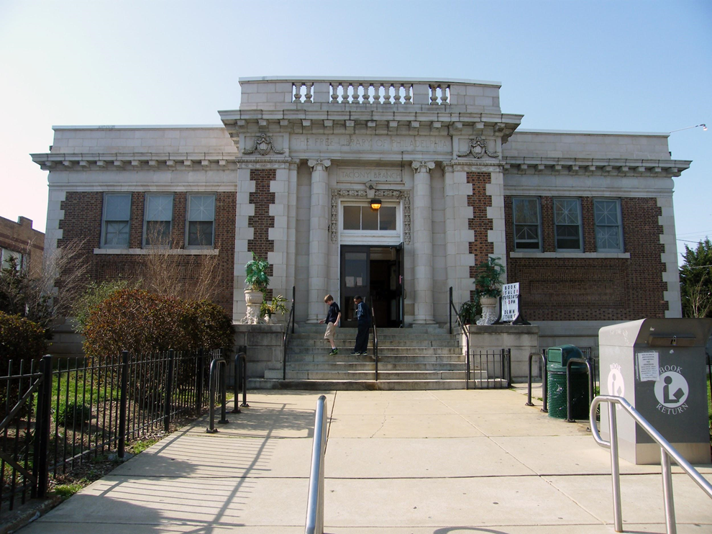
Traditional
FLP’s Tacony Library

Slide 6
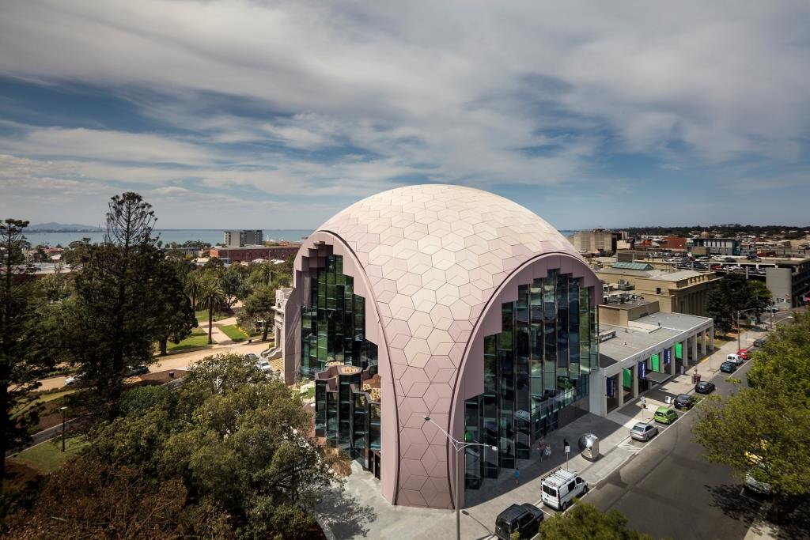
Modern
Geelong
Public
Library
Victoria, AU

Slide 7
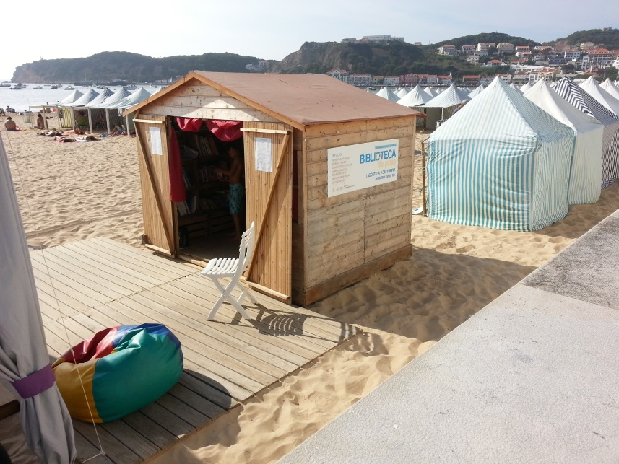
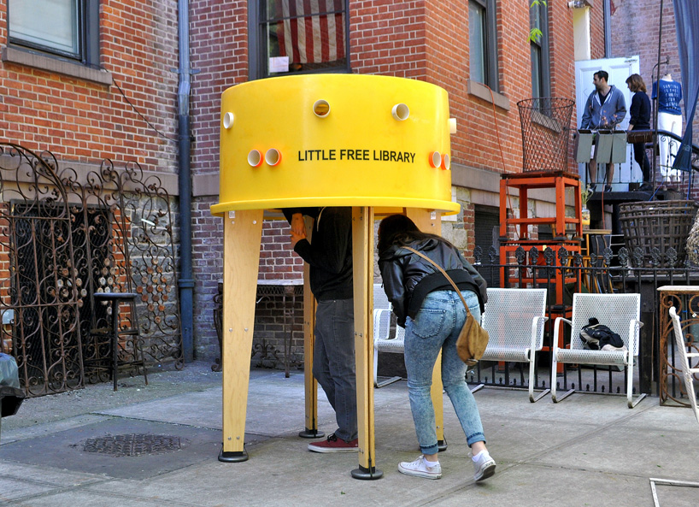
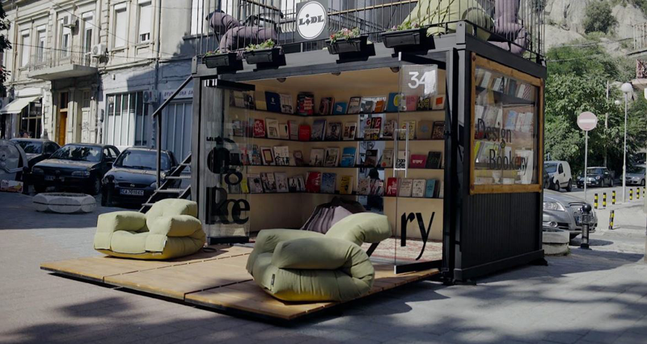
Popup
Italian Riveria
New Zealand Waterfront

Slide 8
Traditional

Slide 9
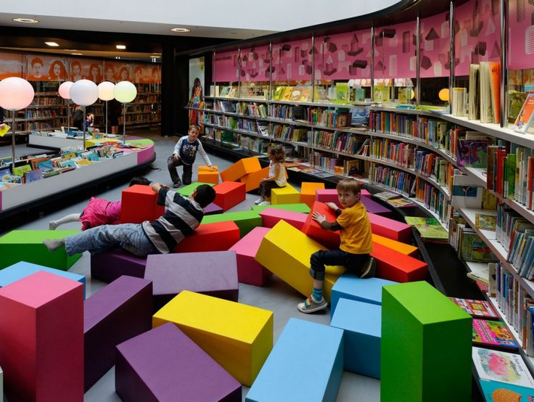
Current
Almere
Public
Library
Netherlands

Slide 10
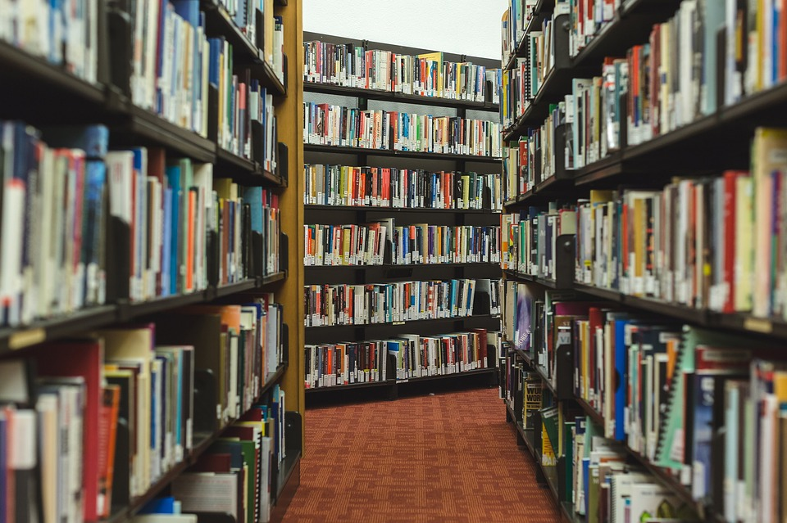
Traditional

Slide 11
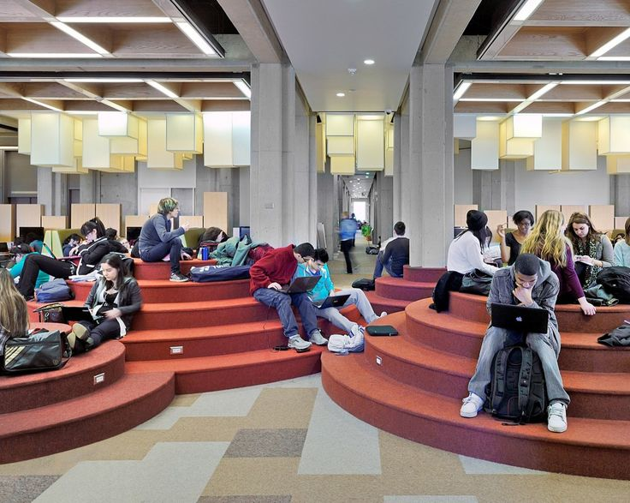
Current
Penn State
Commons

Slide 12
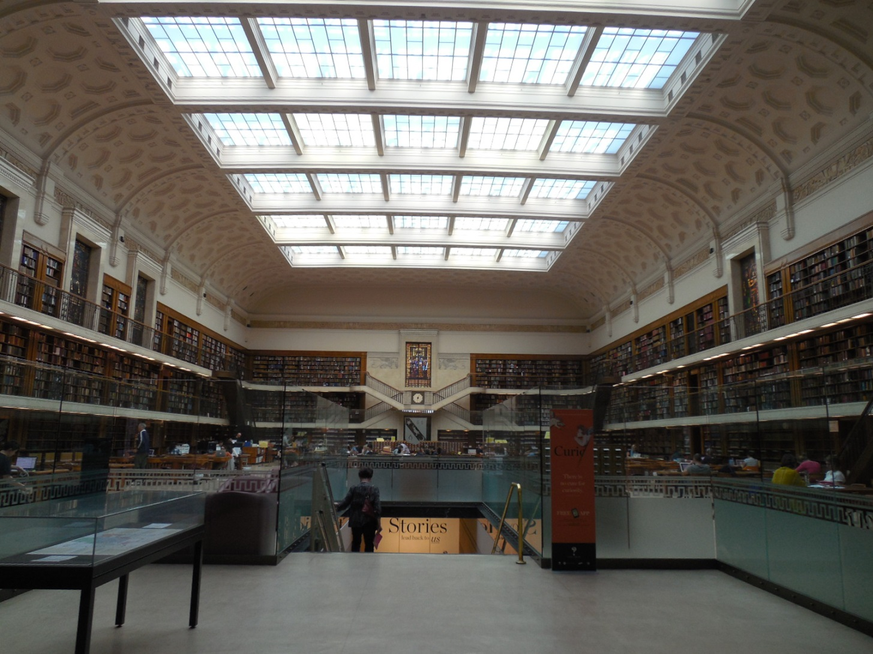
A Quiet Place
National Library - Queensland
Australia

Slide 13
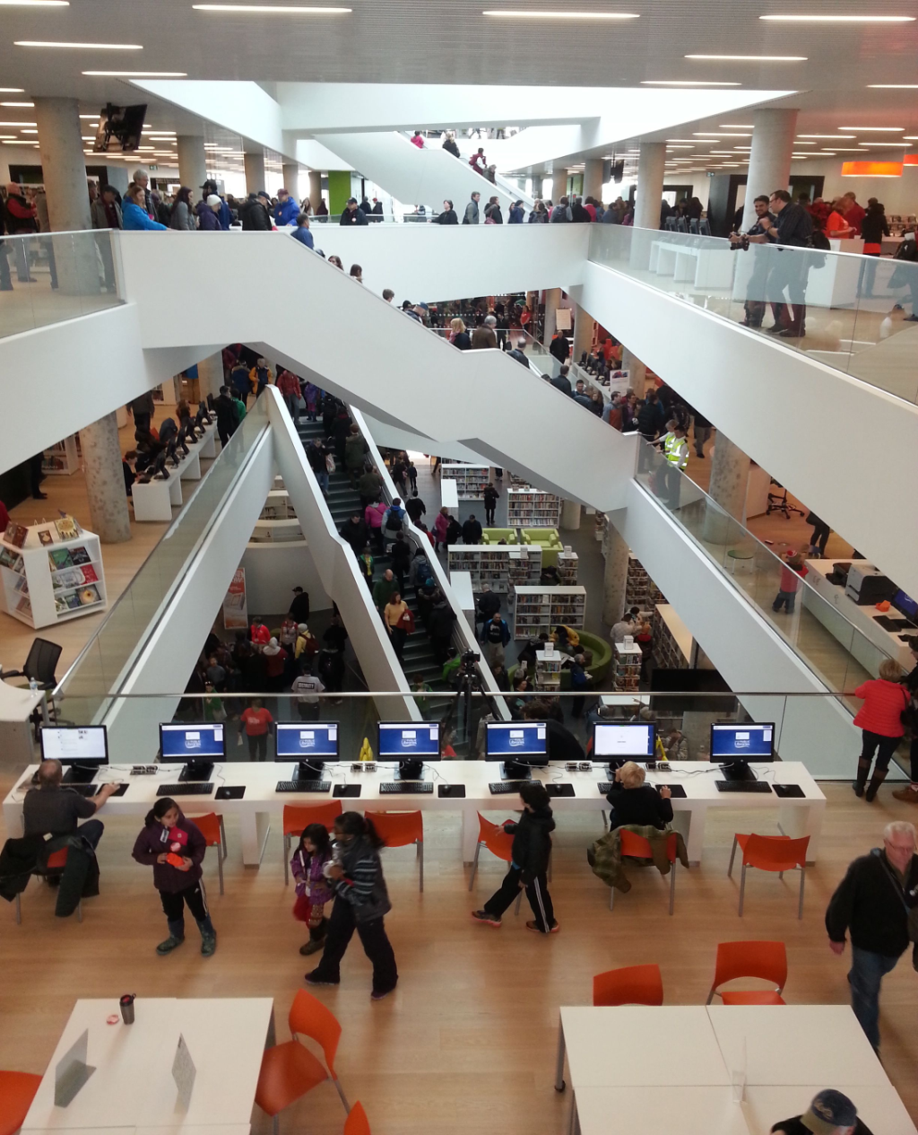
A Highly Activated Place
Central Library
Halifax, NS

Slide 14
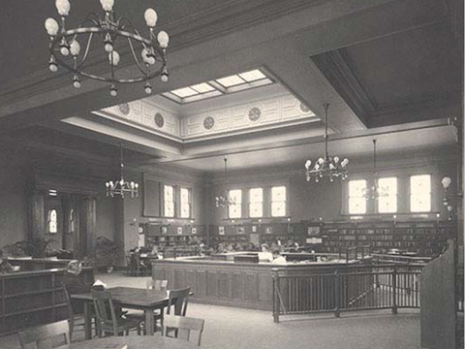
Traditional Interior

Slide 15
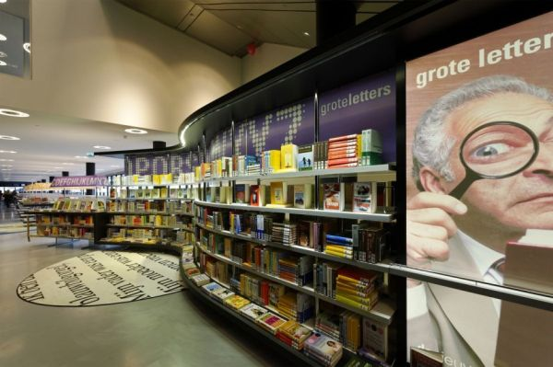
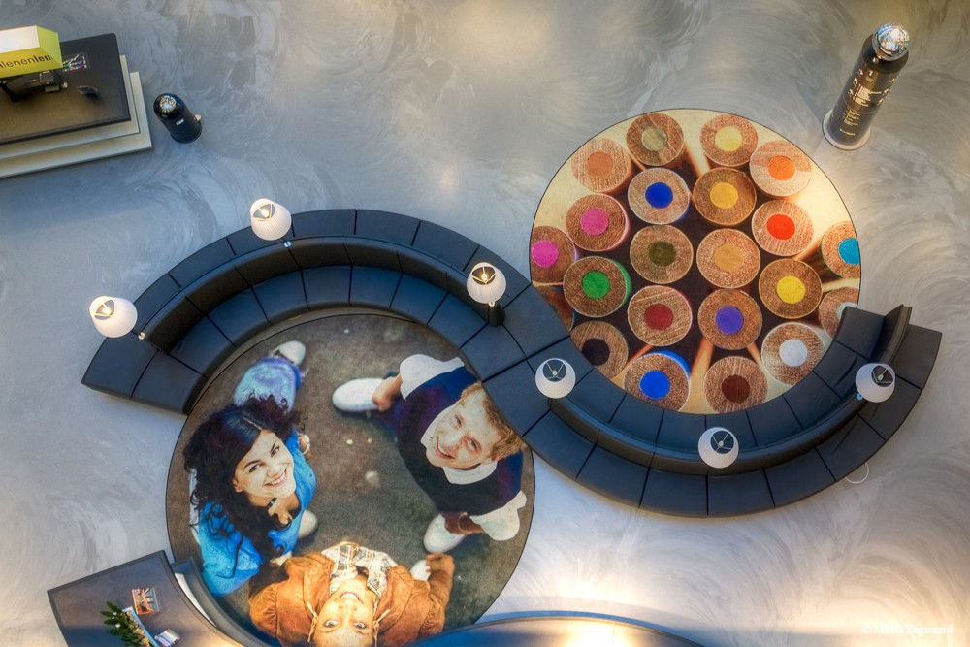
Intriguing Interiors

Slide 16
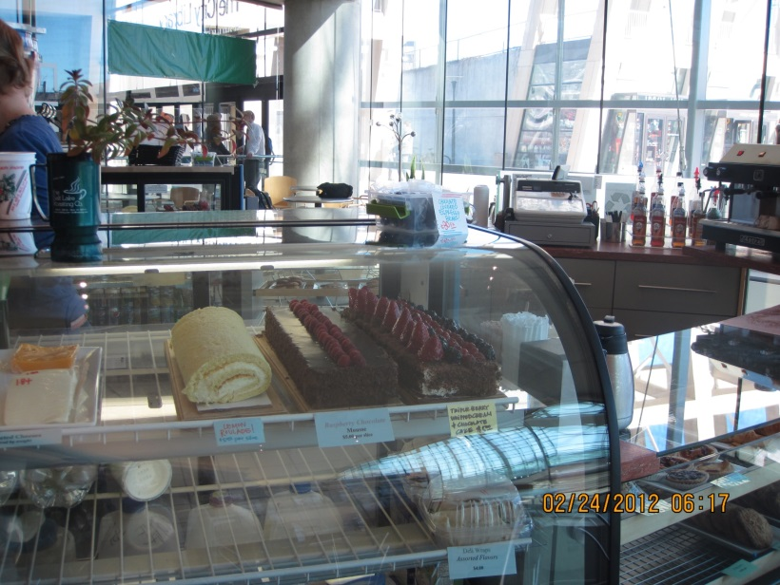
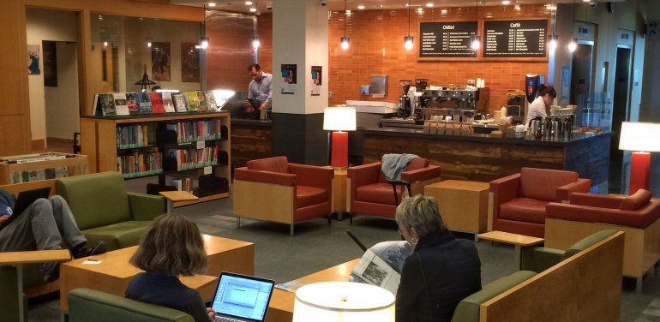
Still conflicted about food

Slide 17
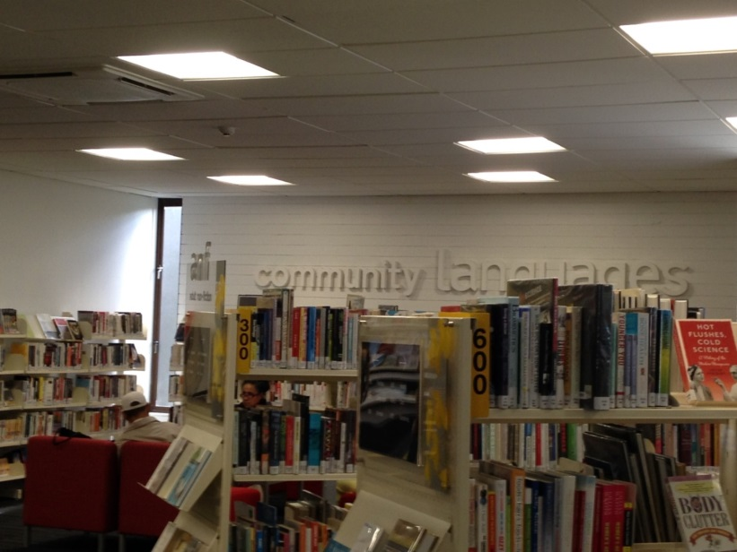
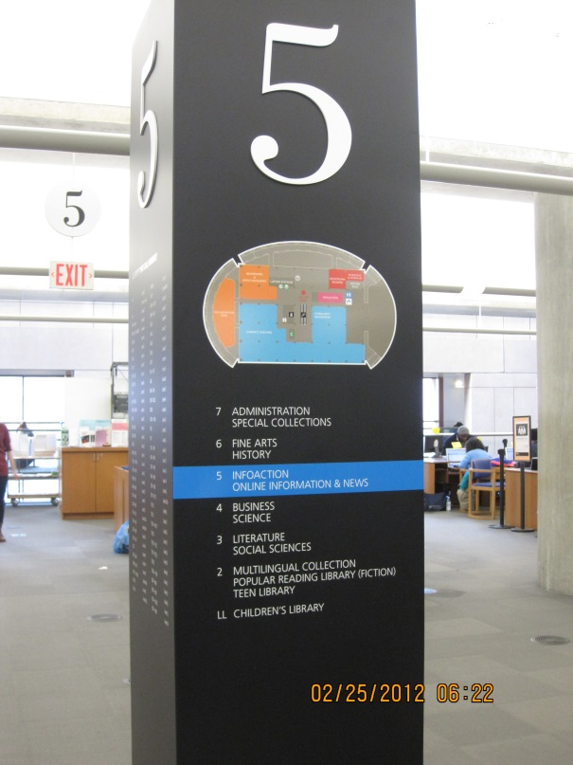
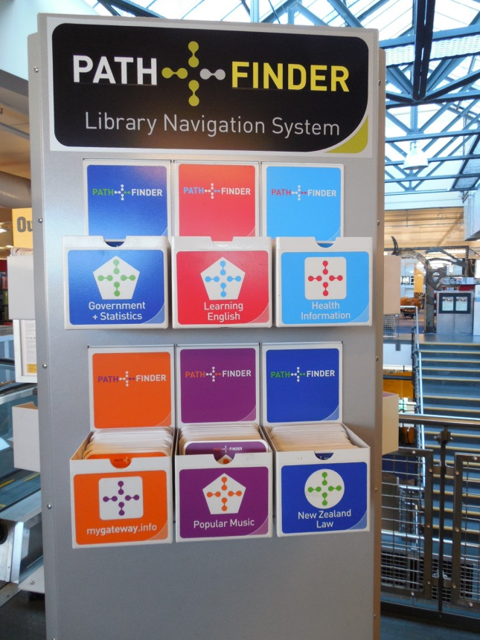
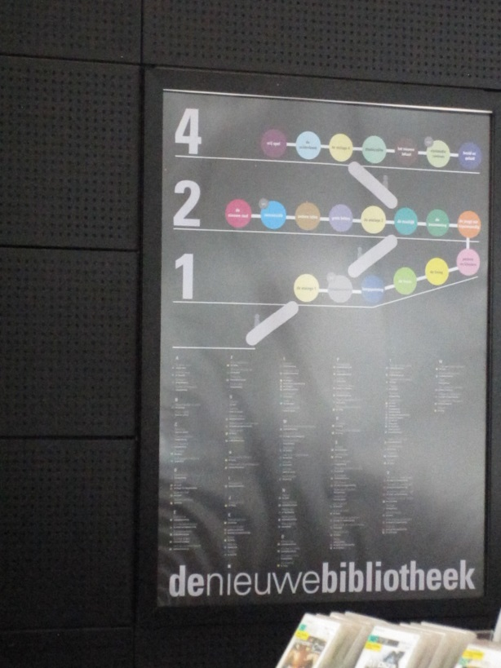
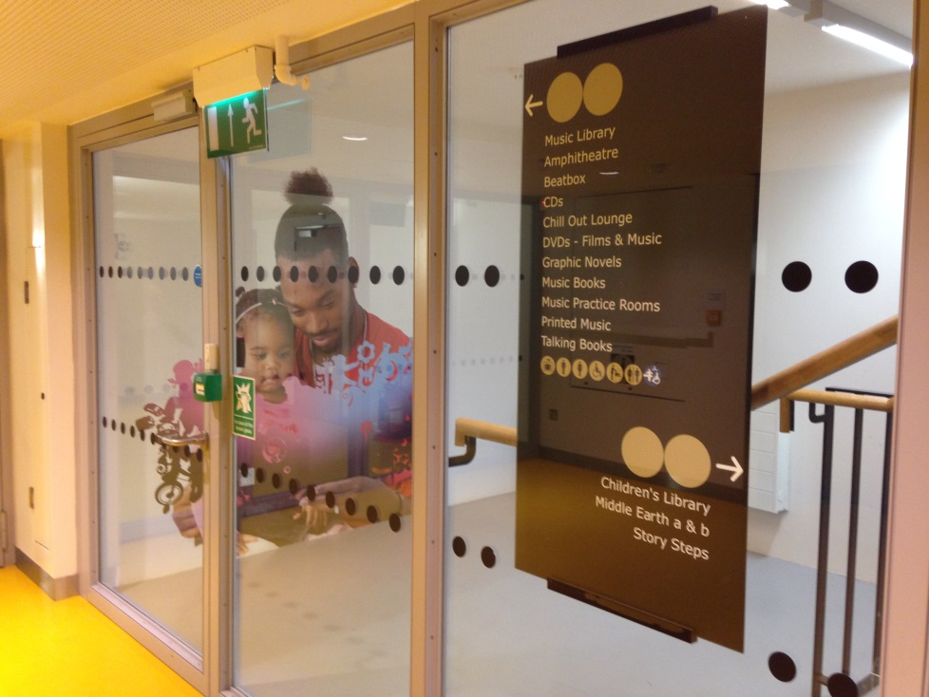
Signage and Wayfinding

Slide 18
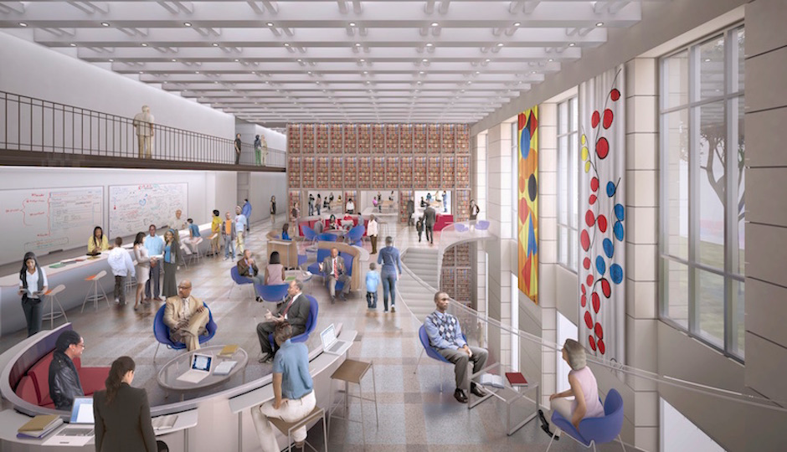
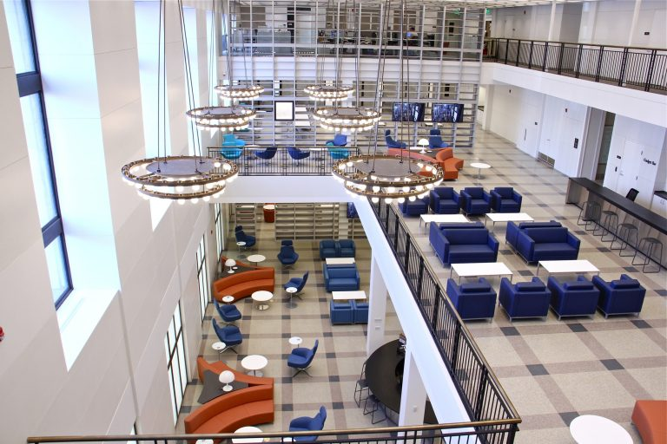
Create Spaces for Civic Dialog by Undoing
Proposed
Actual Result

Slide 22
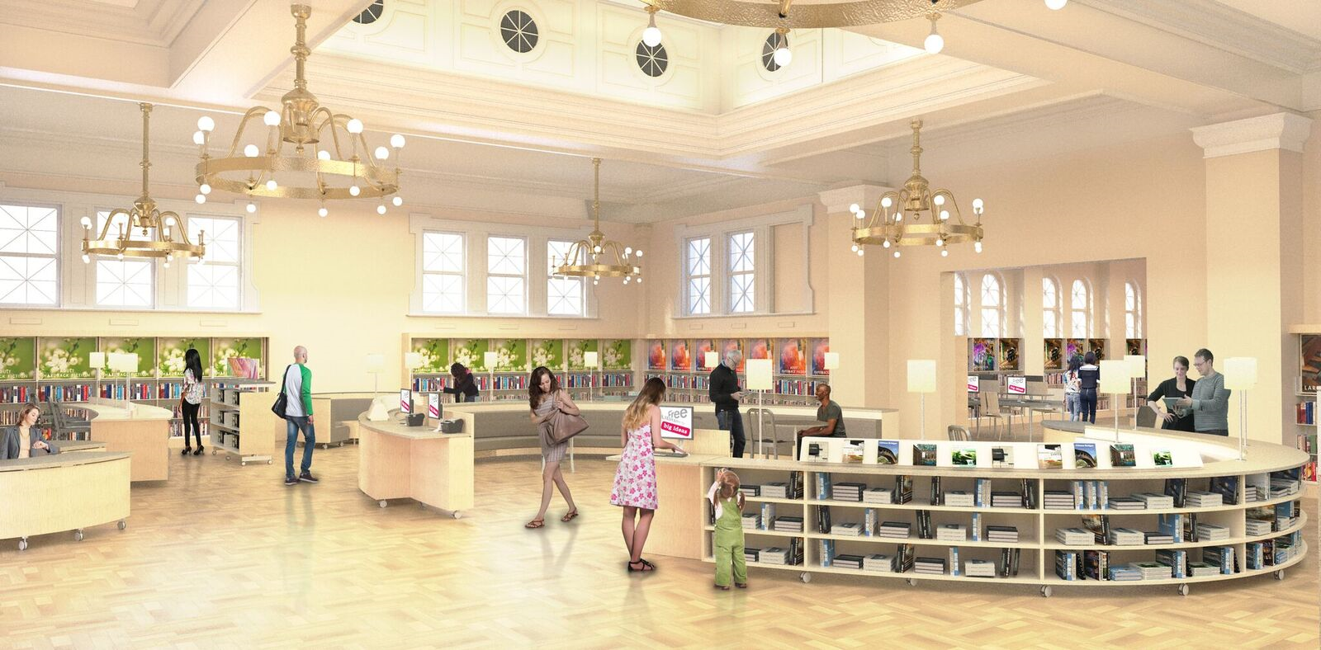
Tacony Library – Interior (New)

Slide 23
Many Thanks
Siobhan A. Reardon
President and Director
James C. Pecora
VP Property Management
Free Library of Philadelphia
www.freelibrary.org
reardons@freelibrary.org
Twitter: @flpdirector

Slide 24
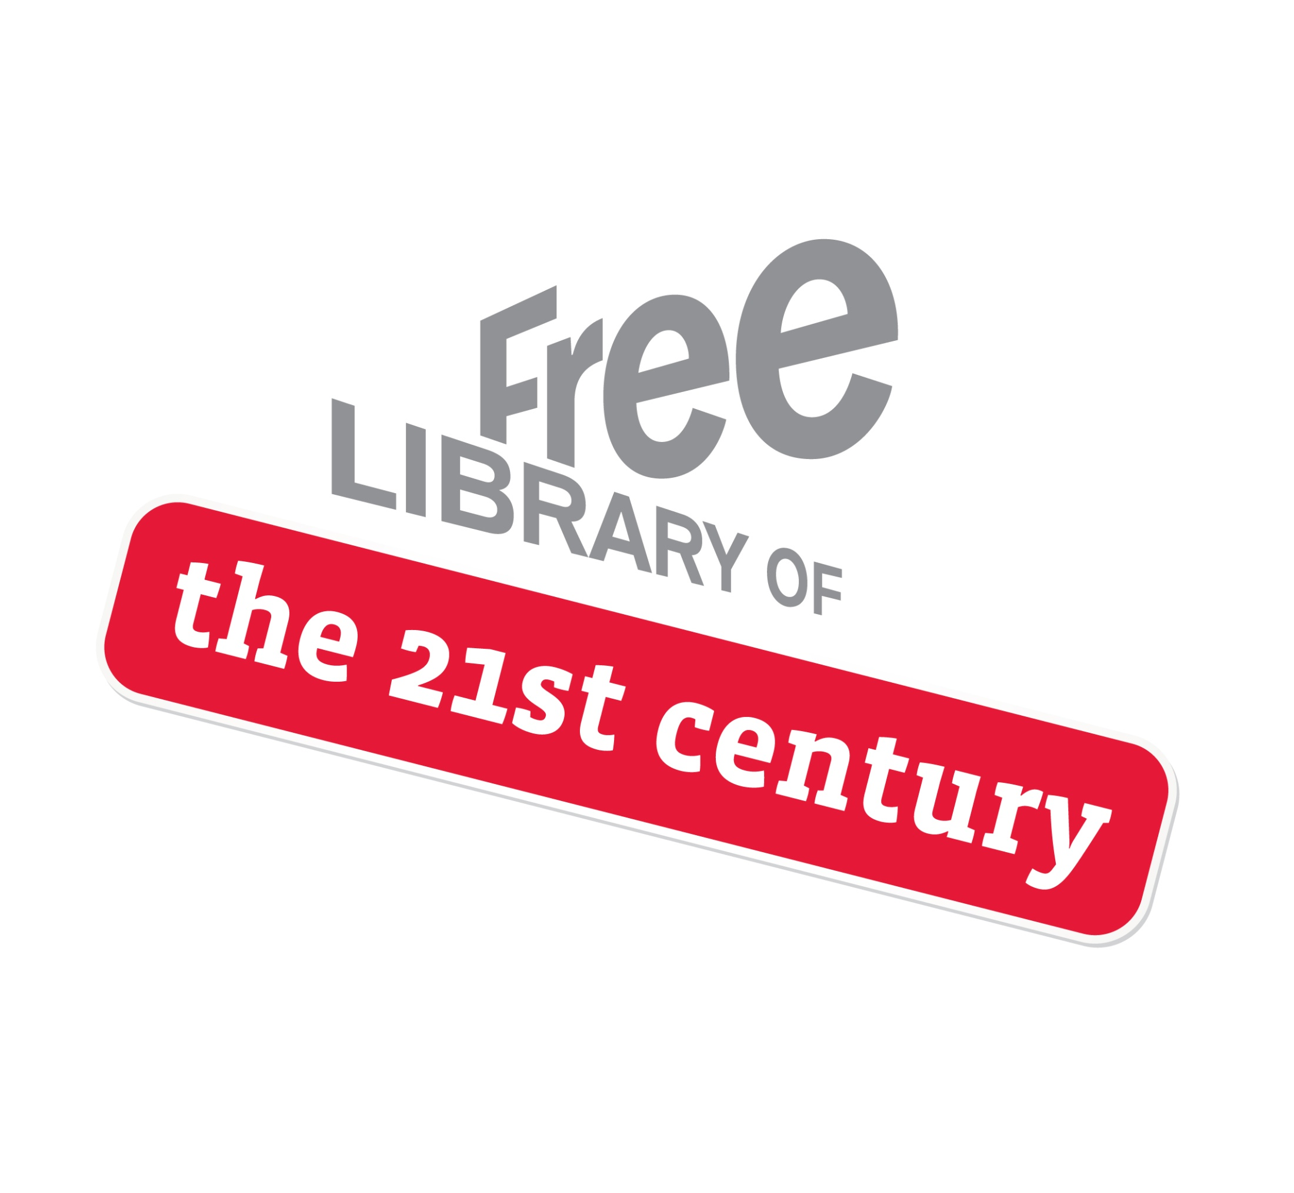
Historic Building
Past, Present, Future

